Slide 1
Chapter 15 Identification of Organic Compounds (Higher Level Only)
Wilt Gu

Slide 2
Analytical techniques
Chemical analysts identify and characterize unknown substances, determine the composition of a mixture, and identify impurities.
Their work can be divided into three types of analysis:
qualitative analysis: the detection of the presence but not the quantity of a substance in a mixture; for example, forbidden substances in an athlete’s blood;
quantitative analysis: the measurement of the quantity of a particular substance in a mixture; for example, the alcohol levels in a driver’s breath;
structural analysis: a description of how the atoms are arranged in molecular structures; for example, the determination of the structure of a naturally occurring or artificial product.

Slide 3
Many instruments are available to provide structural analysis but they generally work by analysing the effect of different forms of energy on the substance analyzed.
Infrared spectroscopy is used to identify the bonds in a molecule.
Mass spectrometry is used to determine relative atomic and molecular masses. The fragmentation pattern can be used as a fingerprint technique to identify unknown substances or for evidence for the arrangements of atoms in a molecule.
Nuclear magnetic resonance spectroscopy is used to show the chemical environment of certain isotopes (hydrogen, carbon, phosphorus, and fluorine) in a molecule and so gives vital structural information.
No one method is definitive, but a combination of techniques can provide strong evidence for the structure.

Slide 4
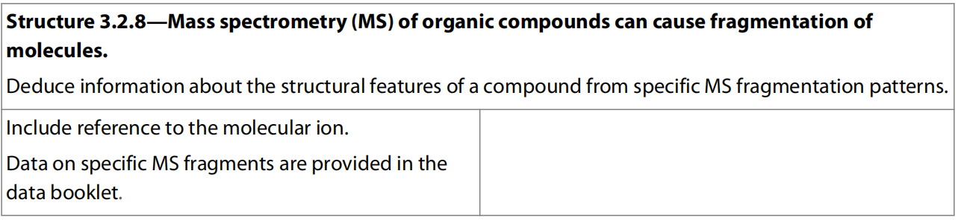
15.1 Mass Spectrometry

Slide 5
Mass spectrometry Determining the molecular mass of a compound
The mass spectrometer was introduced in Chapter 2 where we saw it was used to find the mass of individual atoms and the relative abundances of different isotopes.
The instrument can also be used in a similar way to find the relative molecular mass of a compound.
If the empirical formula is also known from compositional analysis, the molecular formula can be determined.
The technique also provides useful clues about the molecular structure.

Slide 6
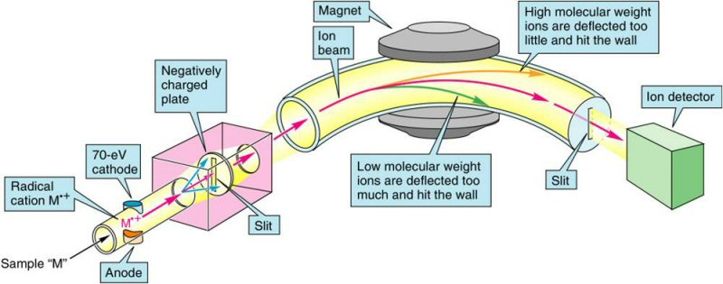
Mass spectrometry (MS) is an analytical technique that measures the mass-to-charge ratio of charged particles.
A mass spectrometer is the instrument which separates particles according to their masses and records the relative proportions of these.

Slide 7
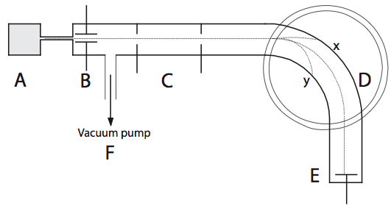
A: Convert substance in vapor phase by heating
B: Turn atom/molecules into positive ions by electron bombardment
C: Accelerate positive ions by electrical field
D: Deflect ions by magnetic field: lighter the particle and the bigger the charge, the greater the deflection (deflection depends on m/z ratio)
E: Detector record ions of a particular mass: greater the number of particles the greater the signal
F: High vacuum maintained by a pump preventing sample particles colliding w/ other particle

Slide 8
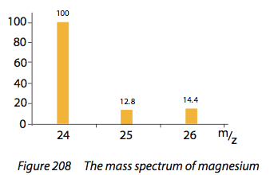
Application
Determine the natural abundances of the isotopes of an element and hence allow calculation of its atomic mass.
Relative Abundance
Natural abundances?
Atomic mass?

Slide 9
Fragmentation patterns
The ionization process in the mass spectrometer involves an electron from an electron gun hitting the incident species and removing an electron:
M (g) + e– → M⁺ (g) + 2 e–
The collision can be so energetic that it causes the molecule to break up into different fragments.
+ e—

Slide 10
The largest mass peak in the mass spectrum corresponds to a parent ion passing through the instrument unscathed, and so shows the relative molecular mass of the molecule.
Other ions, produced as a result of this break up, are also detected.
The fragmentation pattern can provide useful evidence for the structure of the compound.
A chemist pieces together the fragments to form a picture of the complete molecule, in the same way that archaeologists find clues about the past from the pieces of artefacts discovered in the ground.
Consider the diagram in next slide, which shows the mass spectrum of ethanol.

Slide 13
The molecular ion corresponds to the peak at 46.
The ion that appears at a relative mass of 45, one less than the parent ion, corresponds to the loss of a hydrogen atom.
The diagram in the next slide shows fragmentation paths that explain the rest of the spectrum.

Slide 14
For each fragmentation, one of the products keeps the positive charge.
So, for example, if the C – C bond breaks in an ethanol molecule, two outcomes are possible, as seen in Figure 11.16.
The fragmentation shown in Figure 11.16 explains the presence of peaks at both 15 and 31.
Generally the fragment that gives the most stable ion is formed.
The cleavage of the C – O bond leads to the formation of the C₂H₅⁺ ion in preference to the OH⁺ ion in the example above, so there is an observed peak at 29 but not at 17.

Slide 16
A smaller peak is usually found in organic mass spectra at one mass number greater than the main peak.
This is due to the presence in the compound of the isotope ¹³C, which comprises about 1% of naturally occurring carbon.
Its size, relative to the main peak, therefore depends on the number of carbon atoms in the molecule, because if there are six carbon atoms there is an approximately 6% chance (6 × 1%) of there being an atom ¹³C of in the molecule.
This peak can clearly be seen in the diagram in the next slide.

Slide 22
Full analysis of a mass spectrum can be a complex process.
We make use of the mass difference between the peaks to identify the pieces which have fallen off.
You are expected to recognize the mass fragments shown below.
You are not expected to memorize the details as the data are given in section 28 of the IB data booklet.

Slide 29
Exercises
The mass spectrum below is that of a carboxylic acid.
(a) Identify the carboxylic acid in question.
(b) Give the formulae of the species that give rise to the peaks labelled A to F.

Slide 30
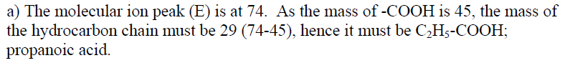
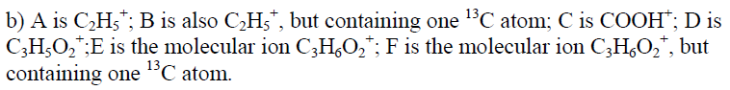

Slide 31
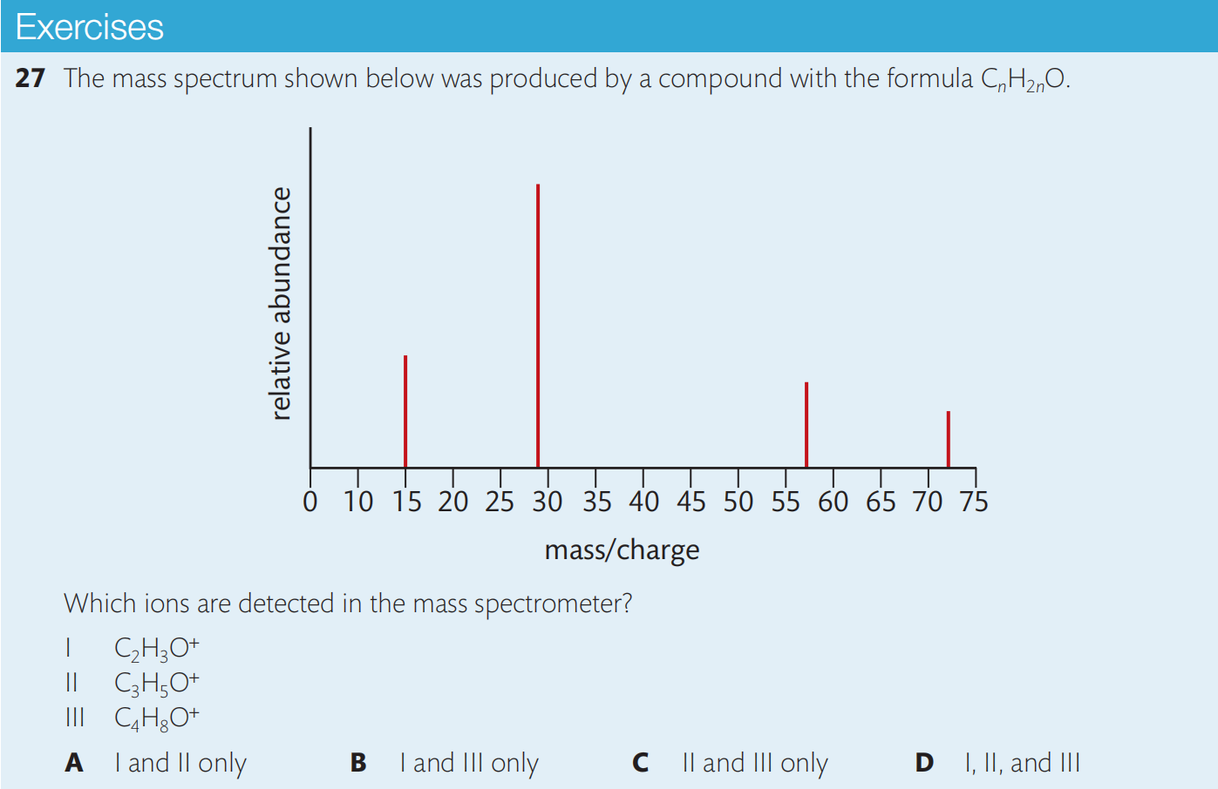

Slide 32
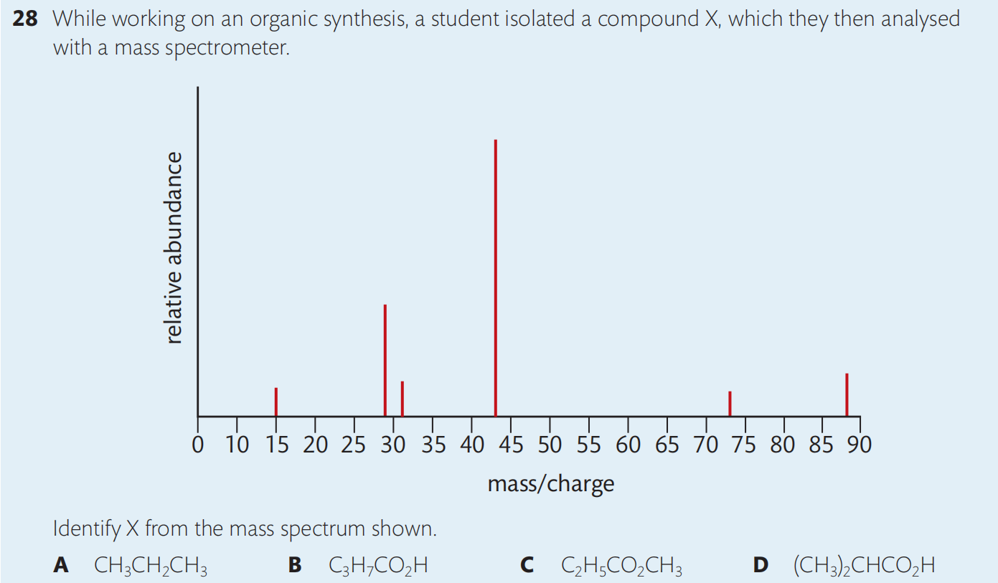
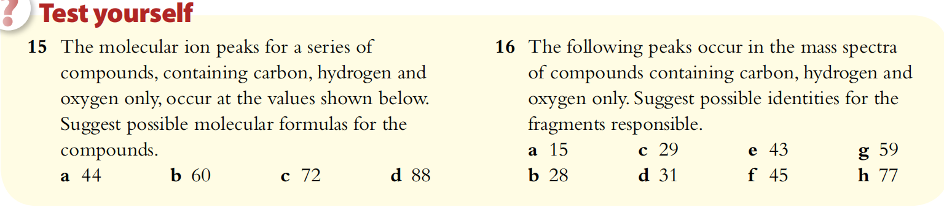

Slide 33
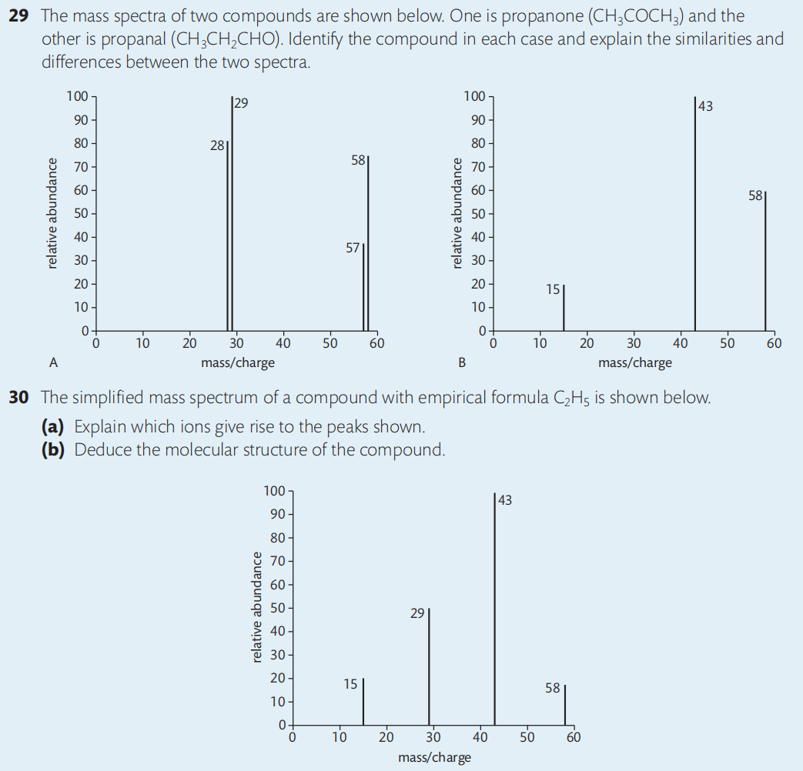

Slide 34
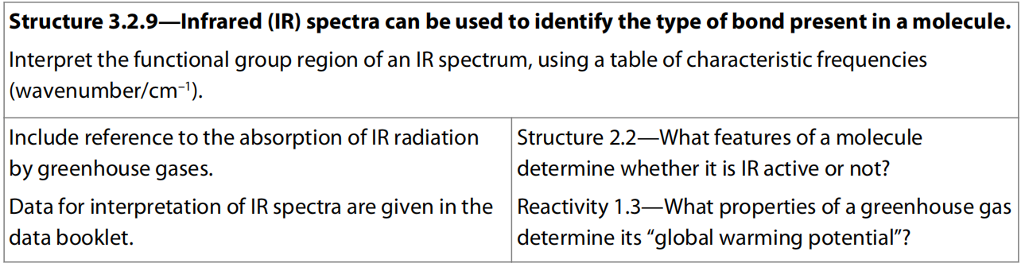
15.2 Infrared Spectroscopy

Slide 35
Different regions of the electromagnetic spectrum give different information about the structure of organic molecules
Spectroscopy is the main method we have of probing into the atom and the molecule.
There is a type of spectroscopy for each of the main regions of the electromagnetic spectrum.
As discussed in Chapter 2, electromagnetic radiation is a form of energy transferred by waves and characterized by its:
wavelength (λ): the distance between successive crests or troughs
frequency (ν): the number of waves which pass a point every second.
The electromagnetic spectrum can be found in section 3 of the IB data booklet.

Slide 36
It should be noted from the table that ν × λ = 3.0 × 10⁸ m s^{–1} = c, the speed of light. This gives ν = c/ λ
In infrared spectroscopy, the frequency of radiation is often measured as number of waves per centimeter (cm^{–1}), also called the wavenumber.

Slide 37
As well as transferring energy, the electromagnetic radiation can also be viewed as a carrier of information. Different regions give different types of information, by interacting with substances in different ways.
Radio waves can be absorbed by certain nuclei, causing them to reverse their spin. They are used in NMR and can give information about the environment of certain atoms.
Microwaves cause molecules to increase their rotational energy. This can give information about bond lengths. It is not necessary to know the details at this level.
Infrared radiation is absorbed by certain bonds causing them to stretch or bend. This gives information about the bonds in a molecule.
Visible light and ultraviolet light can produce electronic transitions and give information about the electronic energy levels within the atom or molecule.
X rays are produced when electrons make transitions between inner energy levels. They have wavelengths of the same order of magnitude as the inter-atomic distances in crystals and produce diffraction patterns which provide direct evidence of molecular and crystal structure.

Slide 38
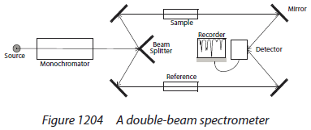
Double beam spectrometer
Same operating principle for IR and UV-Vis spectrometers

Slide 39
IR region is in the range of 4000 – 600 cm⁻¹.
Wave numbers (cm⁻¹) are used as a measure of the wavelength or frequency of the absorption.
Wave number = 1
wavelength (cm)
The greater the wave numbers, the lower the wavelength, the higher the frequency and the greater the energy
IR is not energetic enough to excite an electron to a higher energy level, but to excite a molecule to a higher vibrational level

Slide 40
Infrared (IR) spectroscopy The natural frequency of a chemical bond
A chemical bond can be thought of as a spring.
Each bond vibrates and bends at a natural frequency which depends on the bond strength and the masses of the atoms.
Light atoms vibrate at higher frequencies than heavier atoms and multiple bonds vibrate at higher frequencies than single bonds.
Simple diatomic molecules such as HCl, HBr, and HI, can only vibrate when the bond stretches.
The HCl bond has the highest frequency of these three as it has the largest bond energy and the halogen atom with the smallest relative atomic mass.

Slide 41
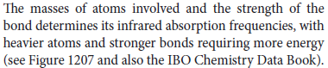
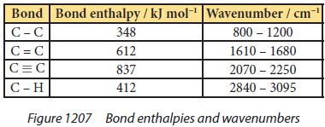

Slide 42
In more complex molecules, different types of vibration can occur, such as bending, so that a complex range of frequencies is present.

Slide 43
Using infrared radiation to excite molecules
The energy needed to excite the bonds in a molecule and so make them vibrate with greater amplitude, occurs in the IR region.
A bond will only interact with the electromagnetic infrared radiation if it is polar.
The presence of separate areas of partial positive and negative charge in a molecule allows the electric field component of the electromagnetic wave to excite the vibrational energy of the molecule.
The change in the vibrational energy produces a corresponding change in the dipole moment of the molecule.
The intensity of the absorption depends on the polarity of the bond.
Symmetrical non-polar bonds in N≡N and O=O do not absorb radiation, as they cannot interact with an electric field.

Slide 45
Stretching and bending in a polyatomic molecule
In a polyatomic molecule such as water, it is more correct to consider the molecule stretching and bending as a whole, rather than considering the individual bonds.
Water, for example, can vibrate at three fundamental frequencies.
As each of the three modes of vibration results in a change in dipole of the molecule, they can be detected with IR spectroscopy.

Slide 46
Vibrational motions
Stretching motions
bending motions

Slide 47

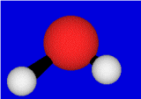

Vibrational motions
Symmetric stretch
Asymmetric stretch
Bending
Stretching motions generally require more energy than bending motions

Slide 48
For a symmetrical linear molecule such as carbon dioxide, there are four modes of vibration.
However, the symmetric stretch is IR inactive as it produces no change in dipole moment.
The dipoles of both C=O bonds are equal and opposite throughout the vibration.

Slide 49
IR active or not?
Practice:
Which vibration motions of the following absorb IR?
H₂O, O₂, HBr, SO₂, NH₃, BF₃

Slide 50
Matching wavenumbers with bonds
The absorption of particular wavenumbers of IR radiation helps the chemist identify the bonds in a molecule.
The precise position of the absorption depends on the environment of the bond, so a range of wavenumbers is used to identify different bonds.
Characteristic infrared absorption bands are shown in the table in the next slide.

Slide 53
Particularly useful absorption peaks
2500-3000 cm⁻¹
–OH hydroxyl group in carboxylic acids
3200-3600 cm⁻¹
–OH hydroxyl group in alcohols and phenols
1700-1750 cm⁻¹
>C=O carbonyl group in aldehydes, ketones, esters
and carboxylic acids

Slide 54
Some bonds can also be identified by the distinctive shapes of their signals.
For example, the O–H bond gives a broad signal and the C=O bond gives a sharp signal.
Hydrogen bonds can be detected by a broadening of the absorptions.
For example, hydrogen bonding between hydroxyl groups changes the O–H vibration; it makes the absorption much broader and shifts it to a lower frequency.

Slide 55
Molecules with several bonds can vibrate in many different ways and with many different frequencies.
The complex pattern can be used as a ‘fingerprint’ shown in about 500 to 1500 cm⁻¹ to be matched against the recorded spectra of known compounds in a database.
A comparison of the spectrum of a sample with that of a pure compound can also be used as a test of purity.

Slide 57
The IR spectrum of heroin (blue) compared with that of an unknown sample (black).
The near-perfect match indicates that the sample contains a high percentage of heroin.
Spectral analysis such as this can identify unknown compounds in mixtures or from samples taken from clothing or equipment.
The technique is widely used in forensic science.

Slide 59
Consider the spectrum of propanone.
The baseline at the top corresponds to 100% transmittance and the key features are the troughs which occur at the natural frequencies of the bonds present in the molecule.
The absorption at just below 1800 cm^{–1} shows the presence of the C=O bond and the absorption near 3000 cm^{–1} is due to the presence of the C–H bond.
The more polar C=O bond produces the more intense absorption.

Slide 60
O-H
C-H

Slide 61
The presence of the C–H bond can again been seen near 3000 cm^{–1} in the spectrum of ethanol.
The broad peak at just below 3400 cm^{–1} shows the presence of hydrogen bonding which is due to the hydroxyl (–OH) group.

Slide 62
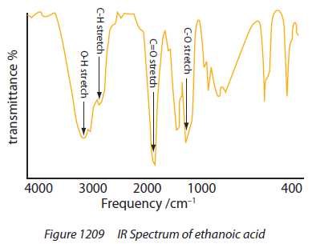

Slide 63
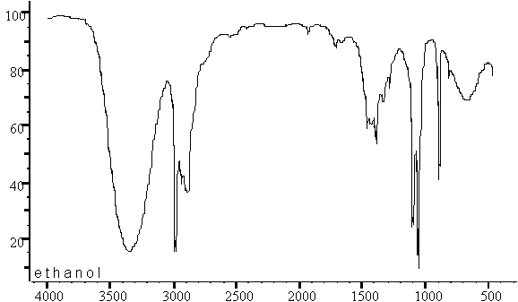
ethanol
O–H

Slide 64
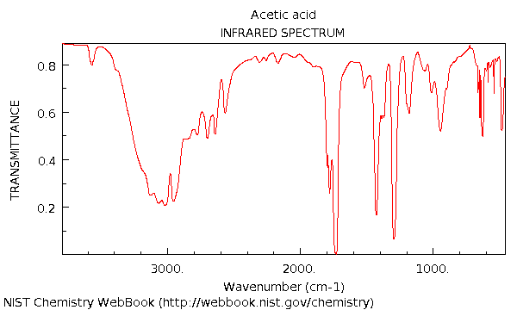
ethanoic acid
O–H

Slide 65
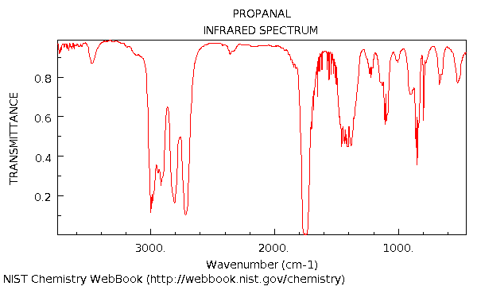
butanal
C=O

Slide 66
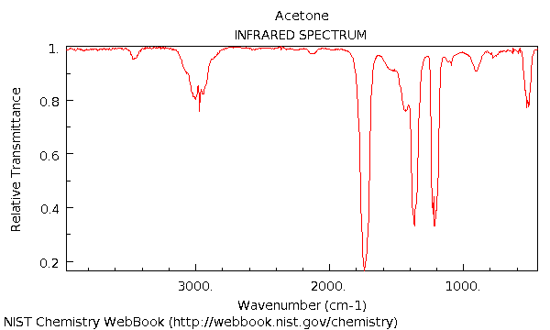
propanone
C=O

Slide 67
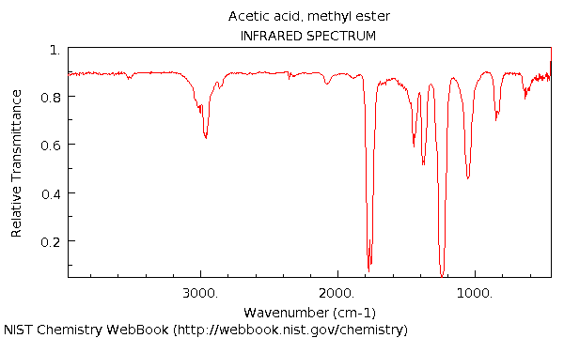
methyl ethanoate
C=O

Slide 68
ethanoic acid
C=O

Slide 69
Below 1500 cm⁻¹ – “Fingerprint”
Complicated and contains many signals – picking out functional group signals difficult.
This part of the spectrum is unique for every compound, and so can be used as a "fingerprint".
A comparison of the "fingerprint" with standard spectra in a database library can be used to identify an unknown compound

Slide 70
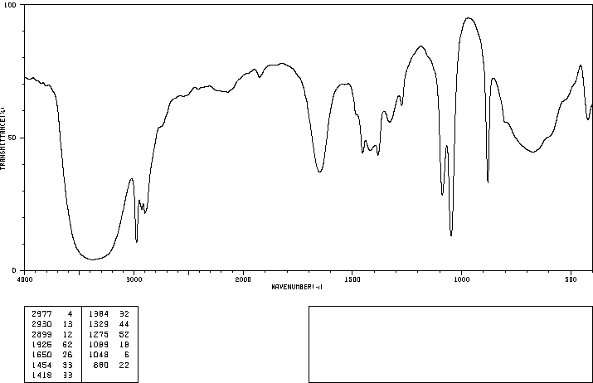
More practice

Slide 71
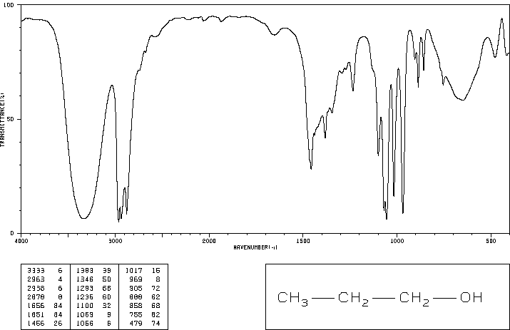

Slide 72
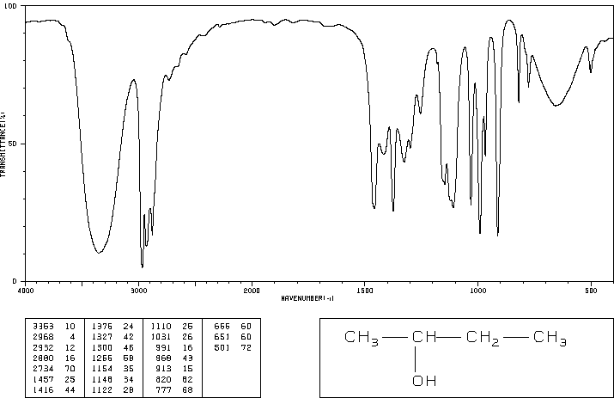

Slide 73
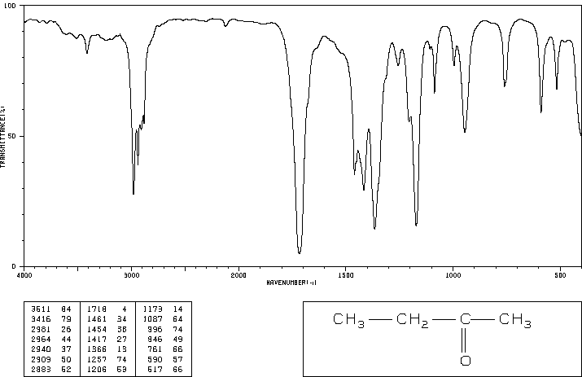

Slide 74
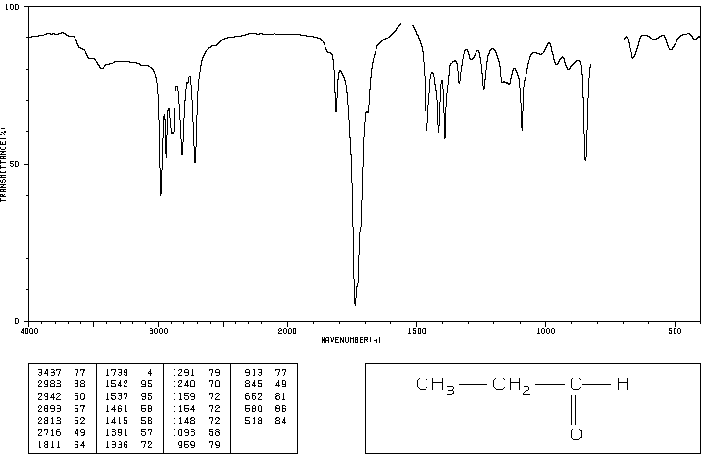

Slide 75
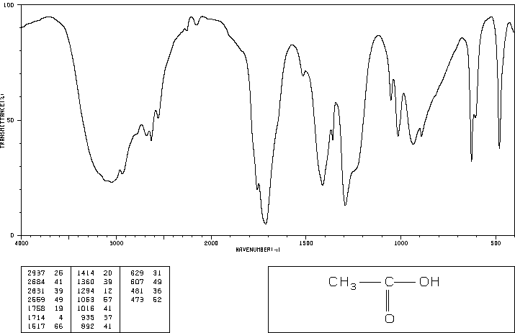

Slide 76
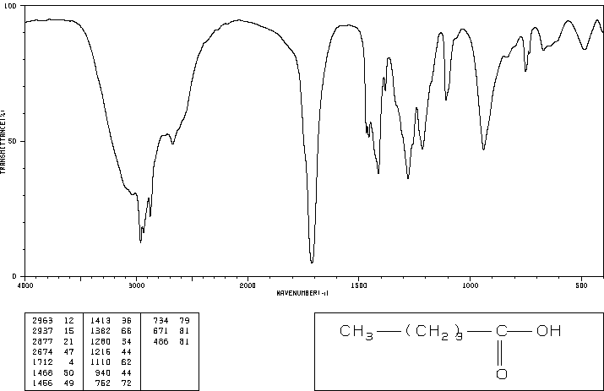

Slide 77
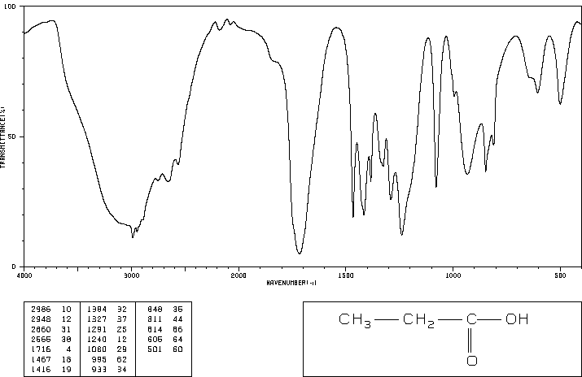

Slide 78
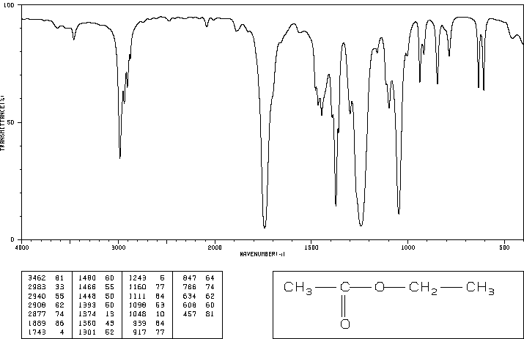

Slide 79
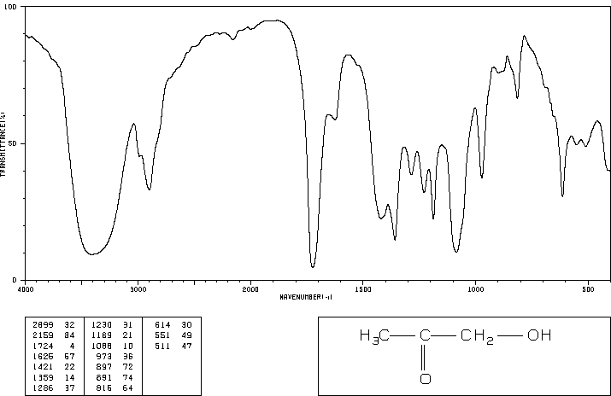

Slide 80
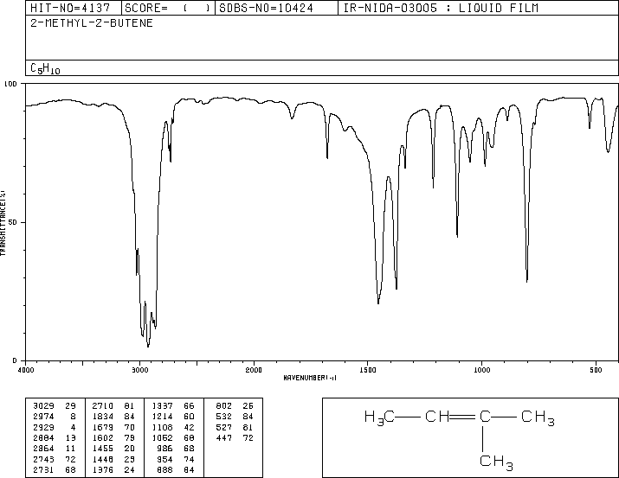

Slide 81
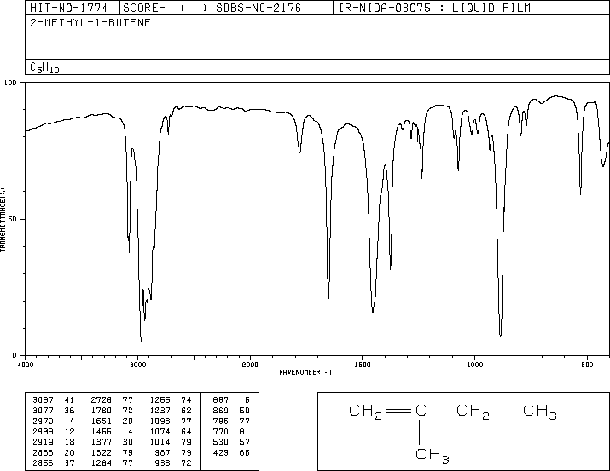

Slide 82
Other techniques need to be combined with IR to differentiate above molecules

Slide 83
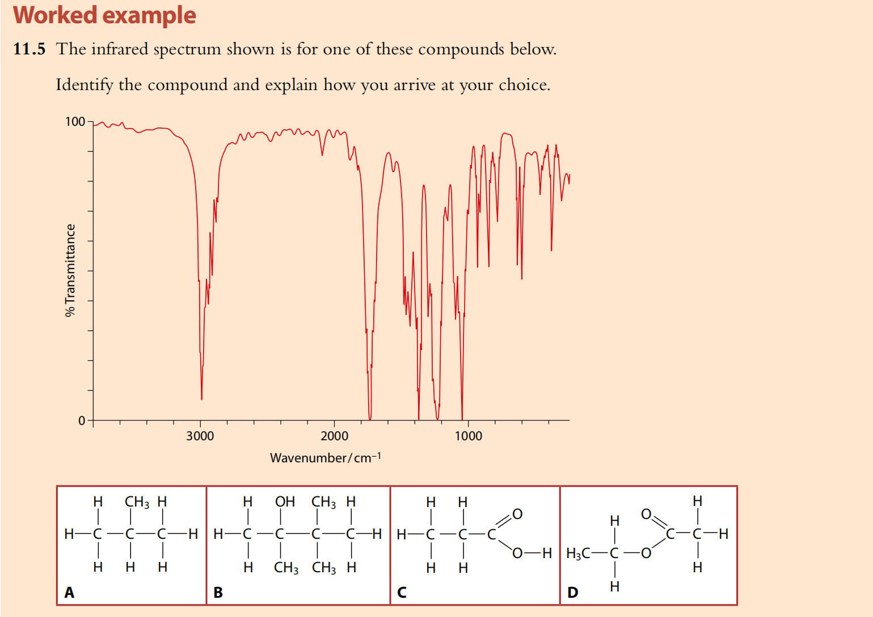

Slide 84
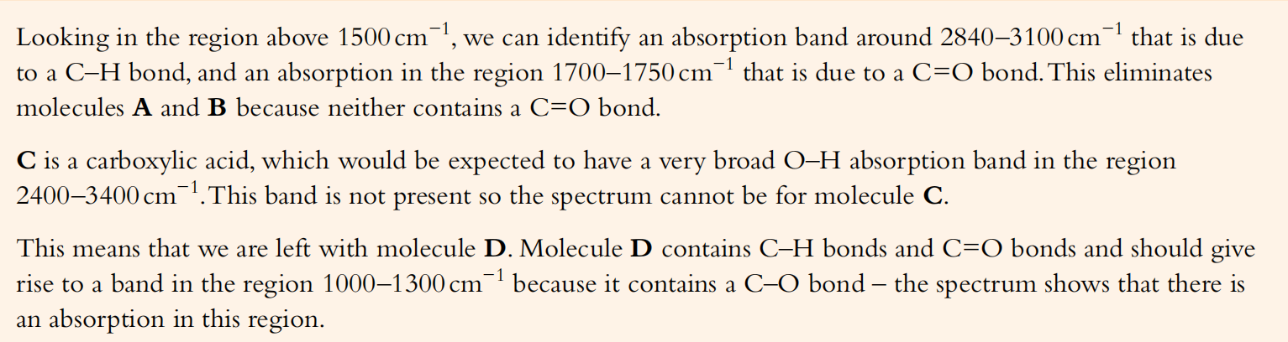

Slide 85
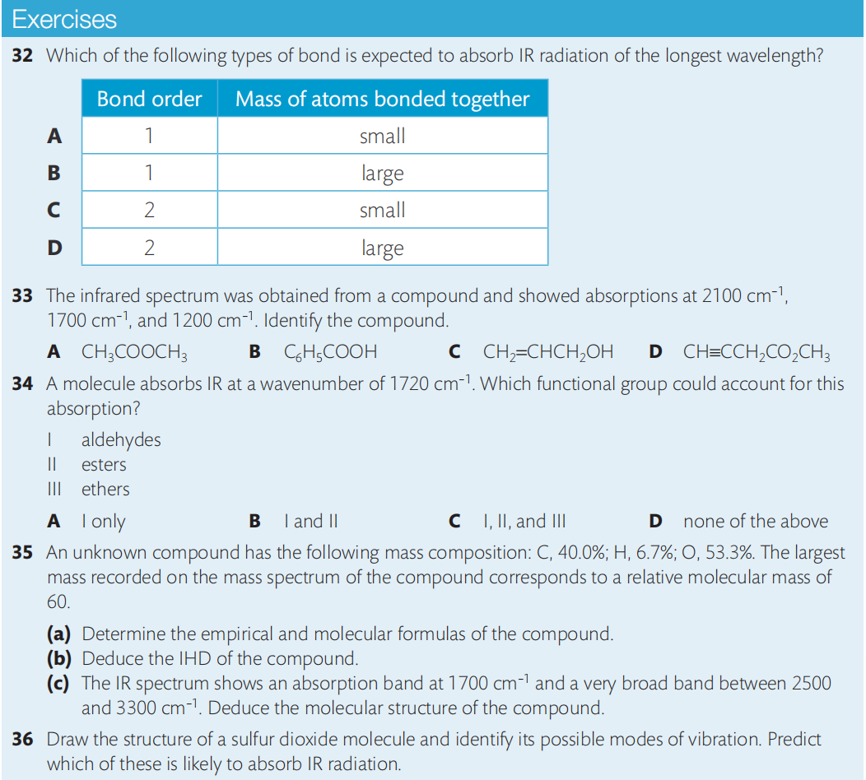

Slide 86
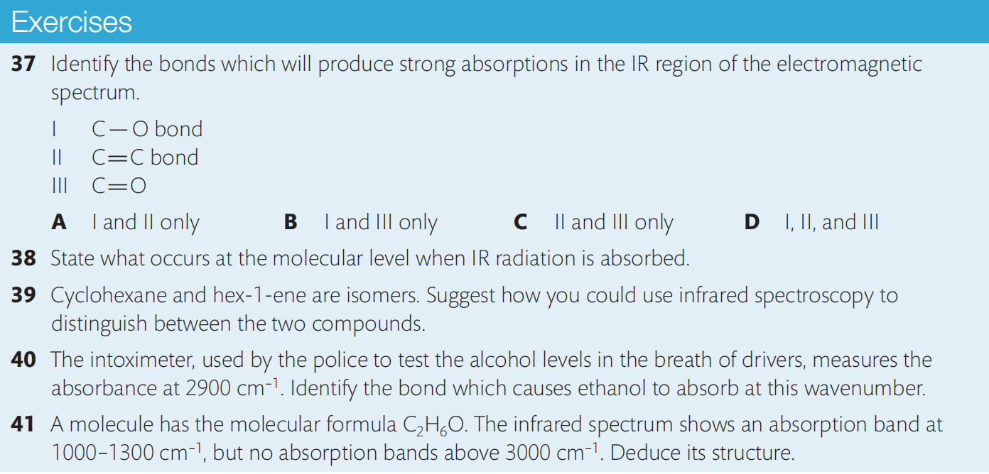
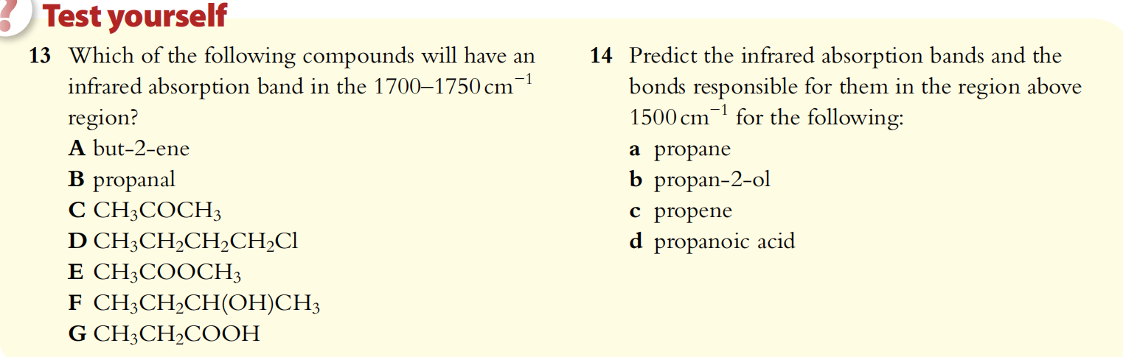

Slide 87
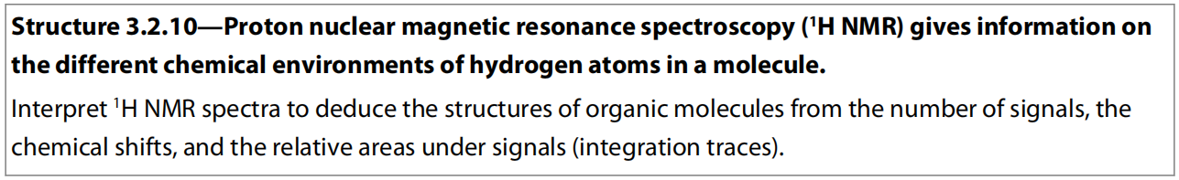
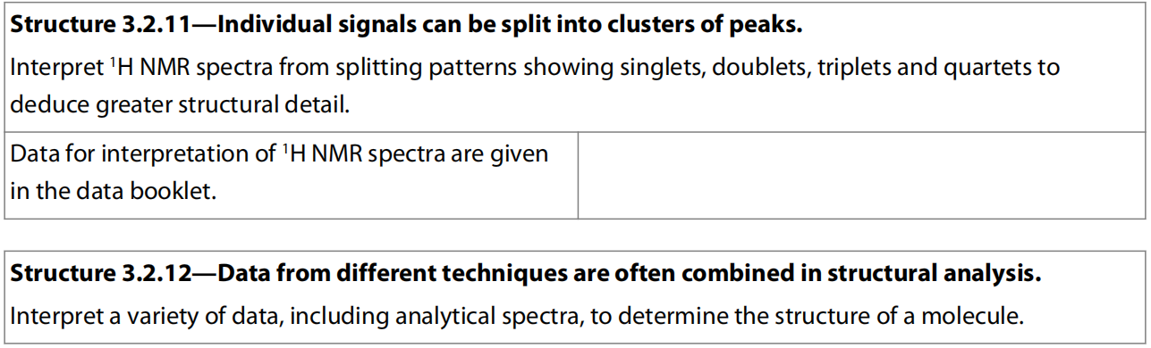
15.3 Hydrogen Nuclear Magnetic Resonance Spectroscopy

Slide 88
Nuclear magnetic resonance (NMR) spectroscopy The principles of NMR
Nuclear magnetic resonance spectroscopy, a powerful technique for finding the structure and shape of molecules, depends on a combination of nuclear physics and chemistry.
The nuclei of atoms with an odd number of nucleons such as ¹H, ¹³C, ¹⁹F, and ³¹P, spin and behave like tiny bar magnets.
If placed in an external magnetic field, some of these nuclei will line up with an applied field and, if they have sufficient energy, some will line up against it.
This arrangement leads to two nuclear energy levels; the energy needed for the nuclei to reverse their spin and change their orientation in a magnetic field can be provided by radio waves.

Slide 89
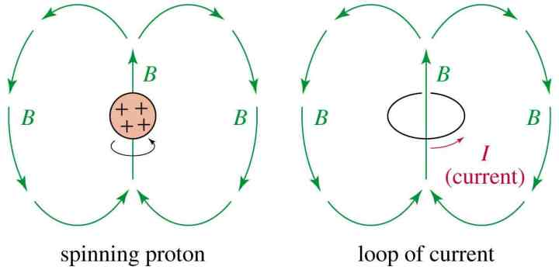
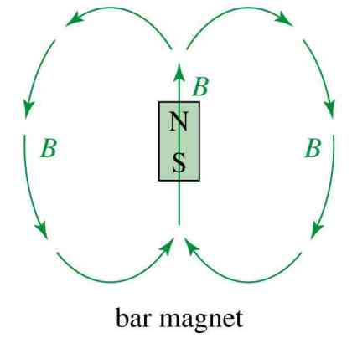
Nuclear Spin
A nucleus with an odd atomic number or an odd mass number has a nuclear spin.
The spinning charged nucleus generates a magnetic field.

Slide 90
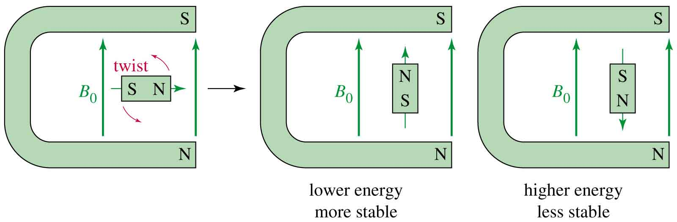
External Magnetic Field
When placed in an external field, spinning protons act like bar magnets.

Slide 91
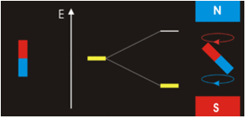
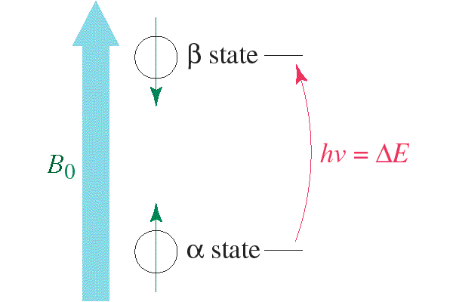
Two Energy States
The magnetic fields of the spinning nuclei will align either with the external field, or against the field.
A photon with the right amount of energy can be absorbed and cause the spinning proton to flip.

Slide 92

The corresponding frequency ν of ΔE falls in the range of radio waves.

Slide 94
In practice, a sample is placed in an electromagnet.
The field strength is varied until the radio waves have the exact frequency needed to make the nuclei flip over and spin in the opposite direction.
This is called resonance and can be detected electronically and recorded in the form of a spectrum.
NMR spectroscopy is non-invasive as the small quantities of the sample are recovered unchanged after the experiment.

Slide 96
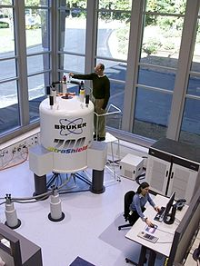
Extension- The NMR Spectrometer

Slide 97
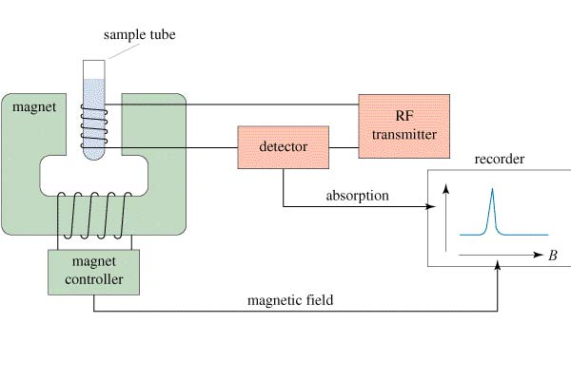
Extension- The NMR Spectrometer

Slide 98
Hydrogen nuclei in different chemical environments have different chemical shifts
As electrons shield the nucleus from the full effects of the external magnetic field, differences in electron distribution produce different energy separations between the two spin energy levels.
The technique is a very useful analytical tool, as nuclei in different chemical environments produce different signals in the spectrum.
Proton or ¹H NMR is particularly useful.
The hydrogen nuclei, present in all organic molecules, effectively act as spies and give information about their position in a molecule.

Slide 99
Magnetic Shielding
If all protons absorbed the same amount of energy in a given magnetic field, not much information could be obtained.
But protons are surrounded by electrons that shield them from the external field.
The amount of shielding depends on where the protons are in a molecule (their chemical environment)

Slide 100
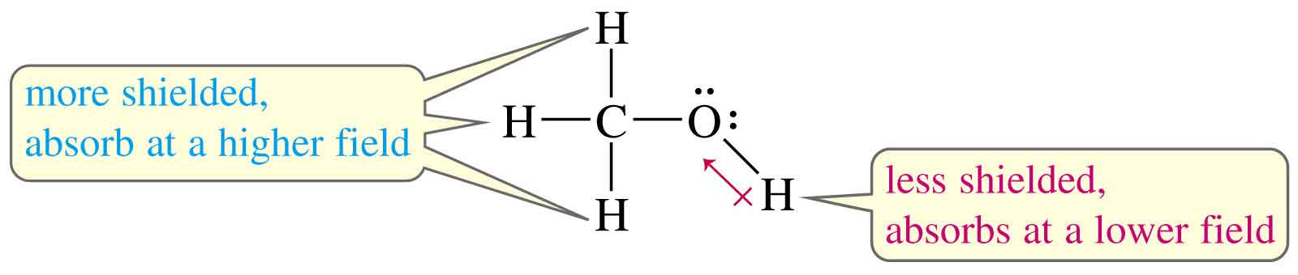
Protons in a Molecule
Depending on their chemical environment, protons in a molecule are shielded by different amounts (Due to electronegativity of different atoms).

Slide 101
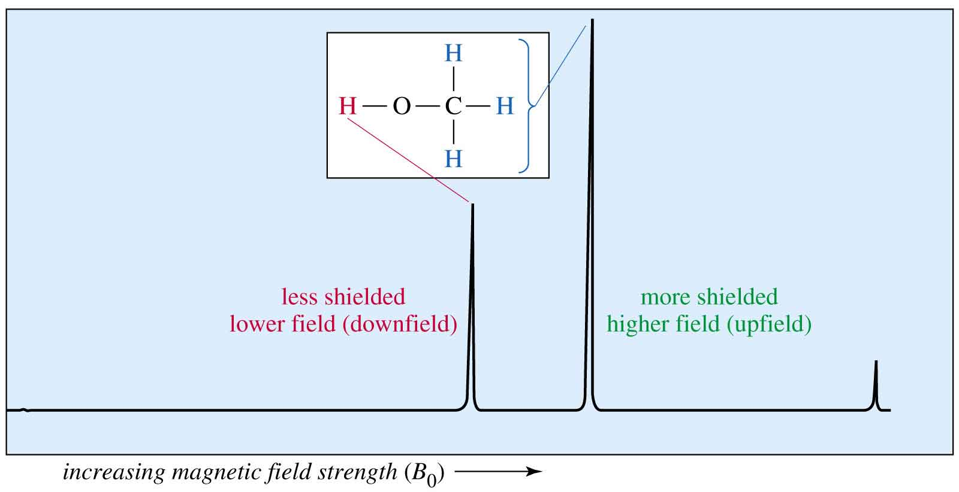
The NMR Spectrum
=>

Slide 102
The signals are measured against the standard signal produced by the 12 hydrogen nuclei in tetramethylsilane (TMS).
In tetramethylsilane, each of the 12 hydrogen atoms is bonded to a carbon atom, which in turn is bonded to two other hydrogen atoms.

Slide 103
The silicon atom is bonded to four methyl groups.
All the hydrogen atoms are in the same environment so only one signal is recorded.
Silicon has a lower electronegativity than carbon, so TMS absorbs radio waves in different regions from that absorbed by hydrogen nuclei attached to carbon, oxygen, or nitrogen atoms.
This ensures that the standard signal does not overlap with any signals under investigation.
The position of the NMR signal relative to this standard is called the chemical shift of the proton.
Hydrogen nuclei in particular environments have characteristic chemical shifts.

Slide 104
TMS has no functional groups (Si-C bond is quite stable) so it is very stable and does not react with almost all organic compounds.
TMS is non-polar and so has a relative low boiling point. It is easy to separate it from the sample.

Slide 105
Chemical Shift
Measured in parts per million.
Ratio of shift downfield from TMS (Hz) to total spectrometer frequency (MHz).
Same value for 60, 100, or 300 MHz machine.
Called the delta scale.

Slide 106
The chemical shift (represented by δ) of a proton in a molecule is defined as:
where ν and ν₀ are the frequencies of the radio waves absorbed by the protons in the sample and TMS respectively.
Although the absolute frequency of the signal depends on the strength of the magnetic field, the chemical shift relative to the standard stays the same.
This allows a standard spectrum to be produced.
TMS has the additional advantages that it is chemically inert and is soluble in most organic solvents.
It can be easily removed from the sample as it has a low boiling point.

Slide 107
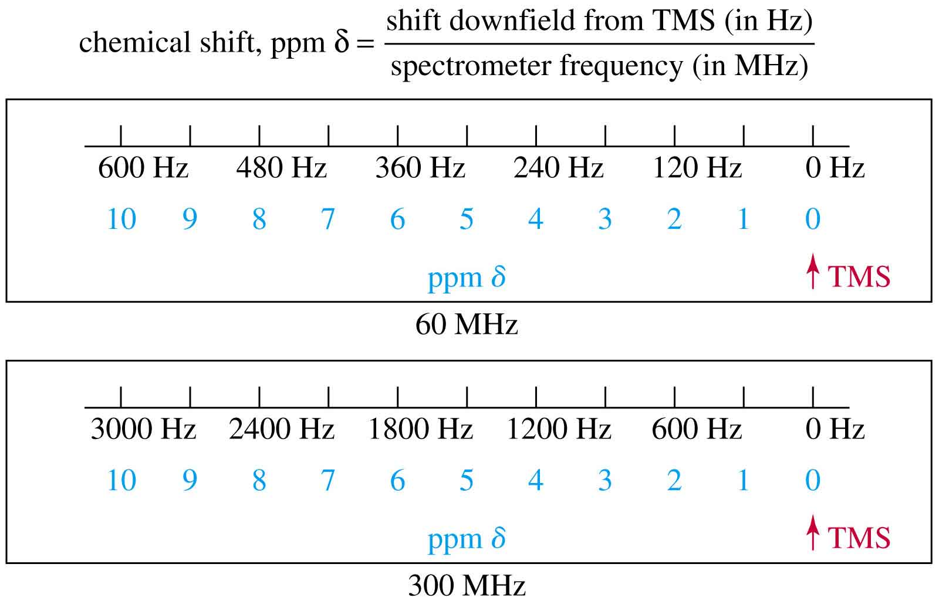
Delta Scale
=>

Slide 108

Location of Signals
More electronegative atoms deshield more and give larger shift values.
Effect decreases with distance.
Additional electronegative atoms cause increase in chemical shift.

Slide 109
Interpreting ¹H NMR spectra
The number of signals shows how many different kinds of hydrogen atoms are present.
The intensity of the signal shows the number of hydrogen atoms of that type. (Peak area---integration trace)
Signal splitting shows the number of hydrogen atoms on adjacent atoms (only in high resolution ¹H NMR).
The location of the signals shows how shielded or deshielded the hydrogen atom is.

Slide 112
* Signals from the hydrogen atoms in the –OH groups are very variable owing to hydrogen bonding.

Slide 113

Number of Signals
Equivalent hydrogens have the same chemical shift.
=>

Slide 114

Intensity of Signals
The area under each peak is proportional to the number of protons.
Shown by integral trace.

Slide 115

How Many Hydrogens?
When the molecular formula is known, each integral rise can be assigned to a particular number of hydrogens.

Slide 116

1,1,2-Tribromoethane
Nonequivalent protons on adjacent carbons.

Slide 118
The spectrum trace has a peak at 9.7, which corresponds to the CHO proton and a peak at 2.1 which corresponds to the three protons in the CH₃ group.
The area under the CH₃ peak is three times larger than that under the CHO peak as it indicates the relative number of protons in each environment.
The integrated trace gives this information more directly, as it goes up in steps which are proportional to the number of protons.

Slide 121
High-resolution ¹H NMR spectroscopy
The NMR spectrum of an organic compound does not generally consist of a series of single peaks shown in the low-resolution spectra presented earlier.
Instead, a sensitive, high-resolution NMR machine reveals a hidden structure, with the single peaks split or resolved into a group of smaller parts.
For example, compare the low-resolution spectrum of ethanal with the one which was obtained under more carefully controlled operating conditions.

Slide 123
The splitting of the peaks occurs as the effective magnetic field, experienced by particular nuclei, is modified by the magnetic field produced by neighboring protons.
This effect is known as spin–spin coupling.
Here the magnetic field experienced by the protons in the methyl group, for example, depends on the spin of the proton attached to the carbon atom of the carbonyl group (CHO).
The local magnetic field is increased when the magnetic field of the CHO proton is aligned with the external field and decreased when aligned against it.
As the energy separation between the two spin states of a proton depends on the local magnetic field, this results in two possible values for the energy difference between the two nuclear energy levels for the CH₃ protons.

Slide 125
Figure (a): The alignment of the magnetic field due to the CHO proton with the external field increases the local magnetic field and the splitting (ΔE) between the energy levels of the CH₃ protons.
Figure (b): The non-alignment of the magnetic field due to the CHO proton with the external field decreases the local magnetic field and the splitting (ΔE) between the energy levels of the CH₃ protons.
Instead of one signal corresponding to one energy difference, ΔE_{a}, two signals corresponding to ΔE_{a} and ΔE_{n} are produced.
Each line corresponds to a different spin of the neighboring proton.
As they are both equally likely, the lines are of equal intensity.

Slide 126
One signal in a low-resolution spectrum produces a doublet in a high-resolution spectrum when there is one proton on a neighboring carbon atom.

Slide 127
In a similar way, the low-resolution peak corresponding to the CHO proton is split due to the different magnetic fields produced by the combinations of spin for the three protons of the neighboring methyl group.
As there are two possible orientations for each proton, a total of 2³ combinations are possible, resulting in four different local magnetic fields.
This produces four signals with relative intensities 1, 3, 3, 1 – as shown in the table below.

Slide 128

Doublet: 1 Adjacent Proton
=>

Slide 129

Triplet: 2 Adjacent Protons
=>

Slide 131

The N + 1 Rule
If a signal is split by N adjacent equivalent protons, it is split into N + 1 peaks.
=>

Slide 132

Splitting for Isopropyl Groups

Slide 133



Slide 135
When analysing high-resolution NMR spectra, the following additional points should be noted:
protons bonded to the same atom do not interact with one another as they are equivalent and behave as a group;
protons on non-adjacent carbon atoms do not generally interact with one another;
the O—H single peak in ethanol does not split unless the sample is pure as rapid exchange of the protons between ethanol molecules averages out the different possible spins.

Slide 143


Slide 144


Slide 145


Slide 146


Slide 147


Slide 148



Slide 149


Slide 150




Slide 151


Slide 152


Slide 153
15.4 Structure Analysis from Combined Spectra Data

Slide 154
Analytical chemistry depends on combining information
The techniques discussed in this chapter provide the analytical chemist with different types of information.
The skill of the analyst is to combine these methods to give a complete description of the structure of the substance being studied.
For example, infrared spectroscopy gives some information about the bonds present in a molecule, but often this information needs to be supplemented with data from other sources to give a complete structure of the molecule.

Slide 161


Slide 162



Slide 163


Slide 164



Slide 165


